Slide 1
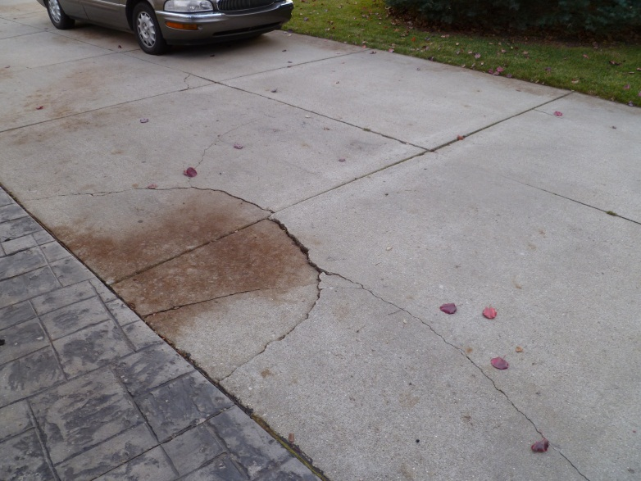
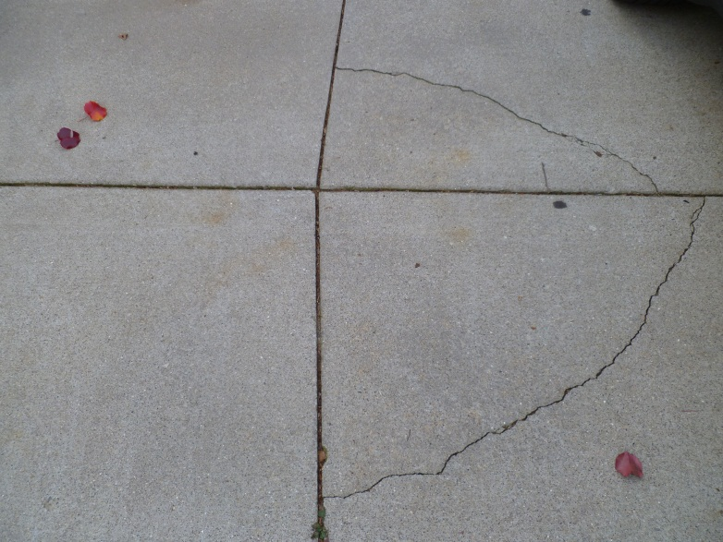
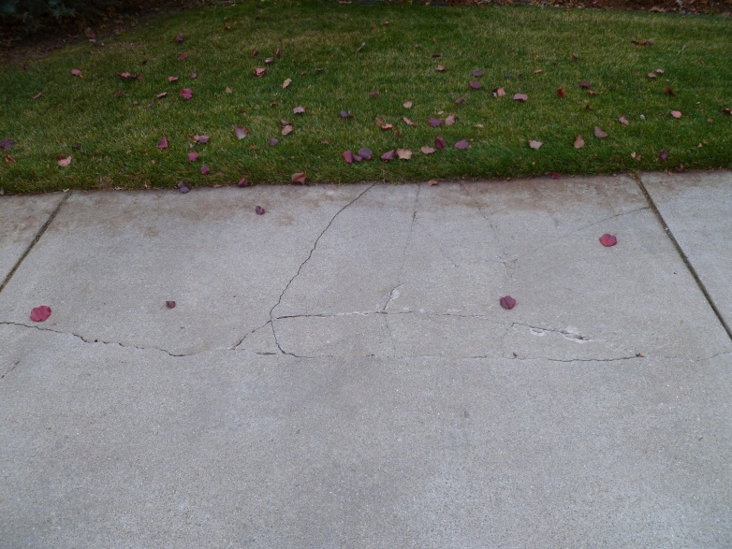
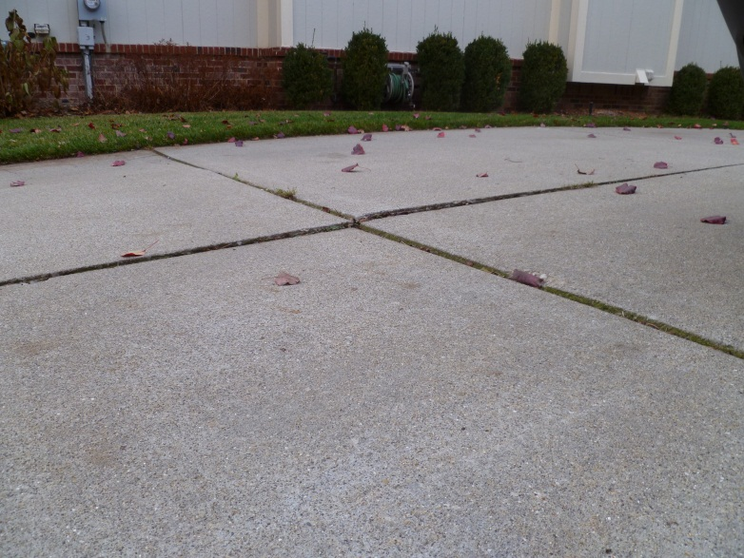
LLWHA Consolidated Buying Power: Concrete Driveway Repair/Replacement
Program Coordinator:
Mike Kutcher
248-668-1658
MJKutcher@aol.com
Cracking
Sinking
Numerous homes within LWHA are in need of driveway repairs/replacement
Consolidating concrete work will yield the best pricing from local reputable suppliers
As part of LLWHA Board services, we will coordinate the consolidation of concrete work so our homeowners get the best price by leveraging our 78 home buying power .
Lifting
Cracking

Slide 2
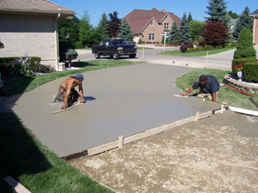
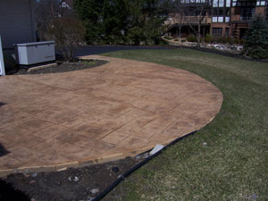
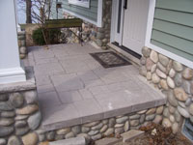
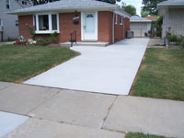
LLWHA Consolidated Buying Power: Concrete Driveway Repair/Replacement
http://www.marcucciconcrete.com/
http://www.fortunaconstruction.com/
The Plan (dates may vary slightly based on interests/needs):
Provide budgetary estimates to homeowners at fall HOA meeting for individual to plan/budget for 2013 repair work (attached)
In spring of 2013, create list of LLWHA interested in concrete work
Provide consolidated list to 2 suppliers for competitive quoting (10May)
Negotiate best pricing based on total volume of consolidated work
Select a single source (1June)
Provide list of interested/committed homeowners to designated supplier. --------At this point LLWHA “coordination is complete”-------
Supplier will work individually with each interested homeowner to define specific homeowner needs/designs/quote , payment plan & timing.

Slide 3
LLWHA Consolidated Buying Power: Concrete Driveway Repair/Replacement
Estimates: thus far (from Marcucci & Fortuna)
$3.50-4/sq for full 4” thick driveway replacement (excluding apron)
$4-6/sqft for 6” thick apron
$4-6/sqft for 4” slab replacements
Example Driveway Project Costs: (all prices include removal & fill)
Front entrance garage 50’x16’ = $2800-3200 (not including apron)
Side entry garage 80’x16’ = $4500-5120 (not including apron)
Apron (16’ wide) to sidewalk = $640-960
Slab ~8’x9’ = $250-290
Note: Suppliers indicated discount can be even greater than listed above depending on volume.
Please note the city sidewalks are the responsibility of the homeowner to maintain / replace.

